Slide 1
VAIDYA
“TELEMED APP WITH DISEASE PREDICTION”

Slide 2

OUR TEAM
Akarsh Bhatt
Sachin Singh
Rachit Bhatia
Vikas Yadav

Slide 3
TABLE OF
CONTENT
01.
02.
03.
04.
Introduction
Objectives and Motivation.
Different Technologies Used
and their working.
Flowchart
And User Interface.
Code
And File Structure.

Slide 4
INTRODUCTION

Slide 5
Problem Statement
India is a country of 140 Crore with majority of the people still residing in rural regions. Due to this, there are many people unable to access to proper medical amenities which might not be available locally. Even if such facilities may be available, there is still the question of which specialist to consult and how to match their schedule to that of the doctor.
Proposed Solution
Our Project aims to address these issues by providing a platform built on the MERN Stack (MongoDB, Express.js, React, Node.js), offering users seamless access to healthcare services.
Users can connect with healthcare professionals through secure video calls, enabling timely consultations from the comfort of their homes.
Users can create profiles, storing their medical history securely. This information helps doctors make more informed decisions during consultations.
By utilizing the ML disease prediction model, users receive immediate assessments based on their provided symptoms, enabling quick insights into potential health issues.

Slide 6
OBJECTIVES
To develop a user-friendly web application which allows the user to self-diagnose himself respective to his/her symptoms, enabling them to select an appropriate medical professional for further treatment.
Ensure that individuals, regardless of their location or physical limitations, can easily access medical consultations, advice, and prescriptions through the web application through virtual interaction medium like video call.
Provide a platform for urgent medical situations where patients can connect with healthcare professionals promptly, avoiding unnecessary delays.

Slide 7
MOTIVATIONS
Accessibility: Telemedicine applications make healthcare more accessible to individuals who may have limited access to traditional healthcare facilities due to geographical, physical, or logistical constraints. This can include individuals in rural areas, those with mobility challenges, or people in underserved regions.
Convenience: Telemedicine offers patients the convenience of accessing healthcare services from the comfort of their homes or workplaces. This reduces the need for travel, waiting times, and the associated inconveniences.
Timely Consultations: Telemedicine applications can facilitate timely consultations, especially in emergencies or situations where rapid medical advice is critical. Patients can connect with healthcare professionals without delays.
Early Intervention: Early prediction of disease enables healthcare providers to intervene and initiate treatment or preventive measures at an earlier stage, potentially reducing the severity of the disease and the associated healthcare costs.
Disease Surveillance: ML models can analyse epidemiological data to detect disease outbreaks and trends, allowing for timely public health responses.

Slide 8
DIFFERENT TECHNOLOGIES
UTILIZED

Slide 9

MongoDB:
MongoDB is a NoSQL, document-oriented database designed for flexibility and scalability. It stores data in BSON (Binary JSON) format, allowing for complex structures and relationships within documents.
Use of NoSQL Databases in Healthcare:
NoSQL databases, including MongoDB, are well-suited for healthcare applications where data structures can be dynamic and complex.
MongoDB's schema-less design accommodates evolving health data requirements.

Slide 10

Express.js:
Express.js is a minimal and flexible Node.js web application framework designed for building robust and scalable web applications. It simplifies the creation of server-side logic, routing, and handling HTTP requests in Node.js applications.
Role in Health App Backend:
Express.js serves as the backend framework within the MERN Stack, managing server-side logic and defining the API endpoints for your health app.
It facilitates the creation of RESTful APIs for communication between the frontend and backend components.

Slide 11

React.js:
React.js is a JavaScript library for building user interfaces, developed by Facebook. It follows a component-based architecture, where UIs are broken down into reusable components.
Use in Health App UI:
React.js is pivotal in creating the dynamic and responsive user interface for our health app.
Components can be customized for various sections like symptom input, disease prediction results, and video call interfaces.

Slide 12

Node.js:
Node.js is a server-side runtime built on Chrome's V8 JavaScript engine, designed for scalability and high-performance network applications.
Role in Health App Backend:
Node.js serves as the backend runtime in the MERN Stack, handling server-side logic and communication with databases and external services.
Node.js facilitates real-time communication through technologies like WebSockets for video calls in your health app.

Slide 13
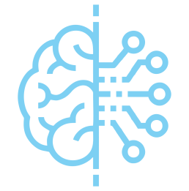
Machine Learning:
Machine learning is a subset of artificial intelligence (AI) that focuses on the development of algorithms and statistical models that enable computer systems to improve their performance on a specific task through experience and data, rather than through explicit programming.
Role of Machine Learning in Health App :
Machine Learning has been used to predict potential disease for the given set of symptoms.

Slide 14
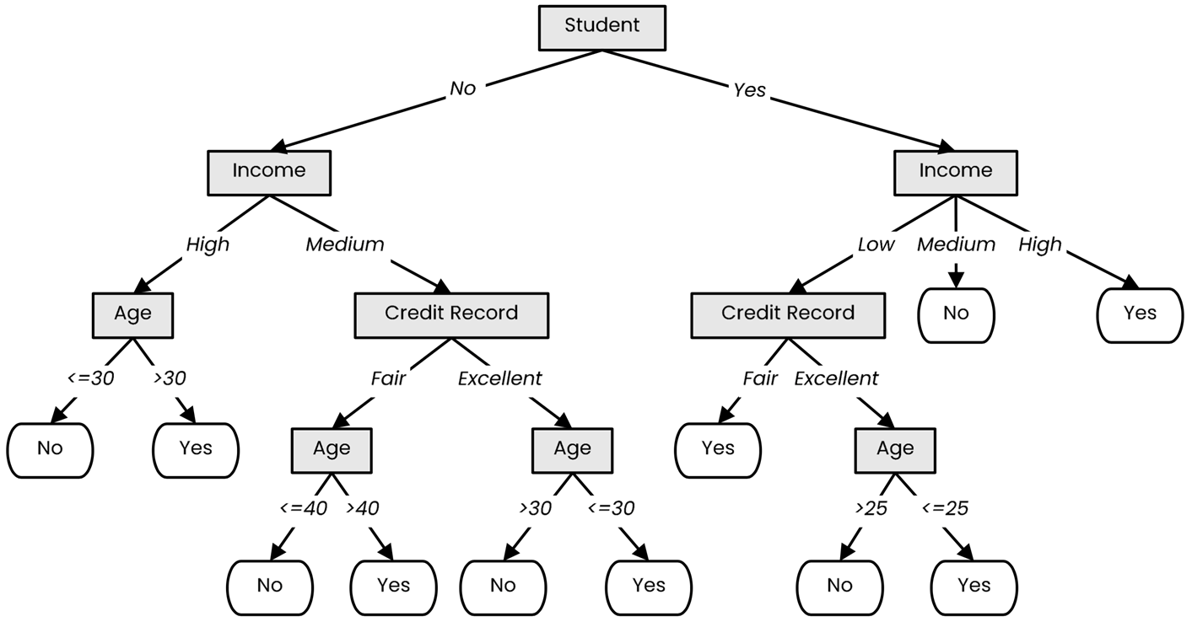
DECISION TREE
A tree-like model that illustrates series of events leading to certain decisions
Each node represents a test on an attribute and each branch is an outcome of that test
Who to loan?
Not a student
45 years old
Medium income
Fair credit record
Student
27 years old
Low income
Excellent credit record

Slide 15
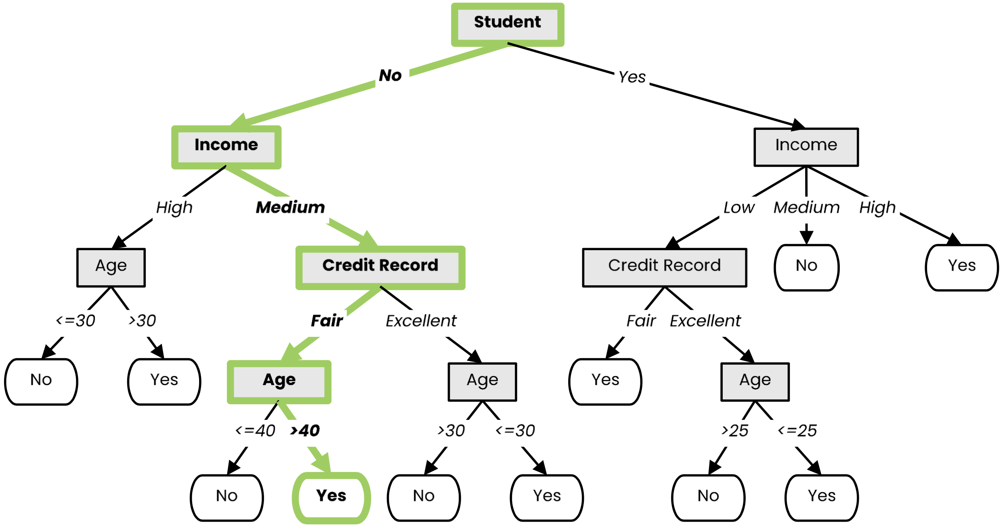
DECISION TREE
A tree-like model that illustrates series of events leading to certain decisions
Each node represents a test on an attribute and each branch is an outcome of that test
Who to loan?
Not a student
45 years old
Medium income
Fair credit record
Yes
Student
27 years old
Low income
Excellent credit record

Slide 16
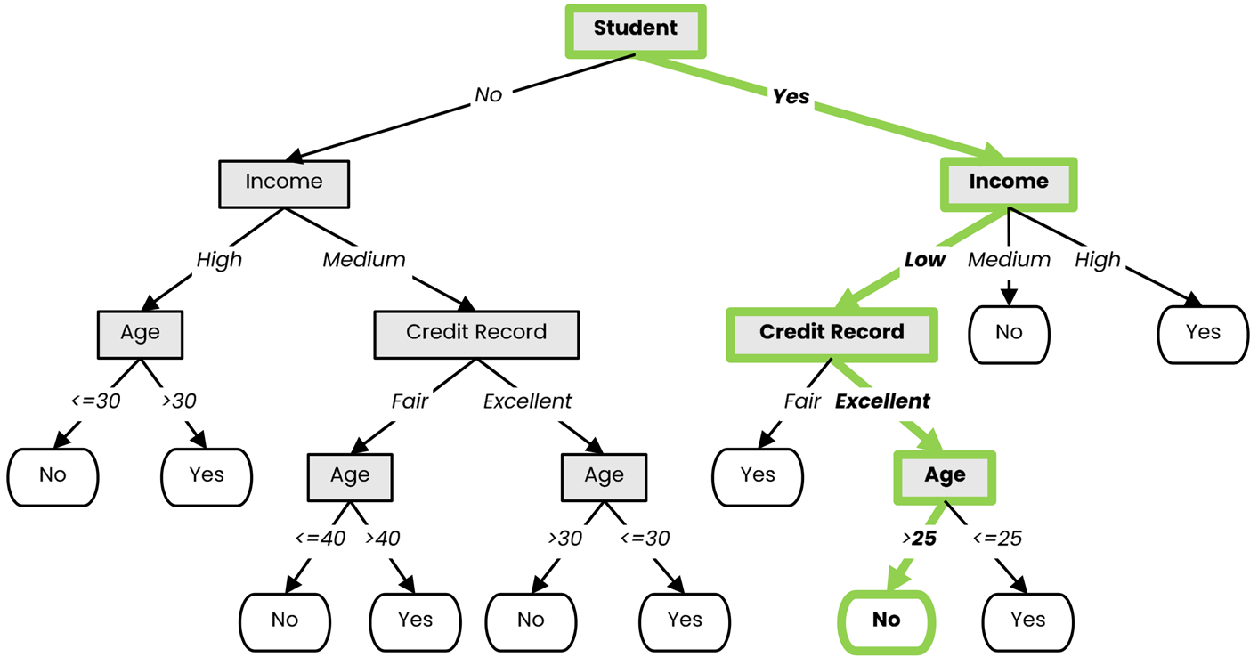
DECISION TREE
A tree-like model that illustrates series of events leading to certain decisions
Each node represents a test on an attribute and each branch is an outcome of that test
Who to loan?
Not a student
45 years old
Medium income
Fair credit record
Yes
Student
27 years old
Low income
Excellent credit record
No

Slide 17
RANDOM FOREST
Random Forests:
Instead of building a single decision tree and use it to make predictions, build many slightly different trees and combine their predictions
We have a single data set, so how do we obtain slightly different trees?
1. Bagging (Bootstrap Aggregating):
Take random subsets of data points from the training set to create N smaller data sets
Fit a decision tree on each subset
2. Random Subspace Method (also known as Feature Bagging):
Fit N different decision trees by constraining each one to operate on a random subset of features

Slide 18









Bagging at training time
N subsets (with replacement)
Training set

Slide 19





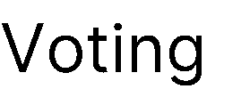



Bagging at inference time
A test sample
75% confidence

Slide 20
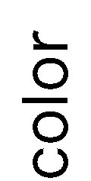


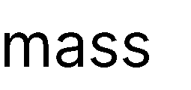





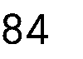

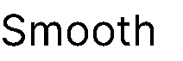
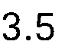

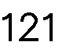
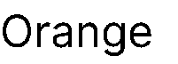

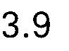
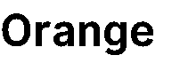
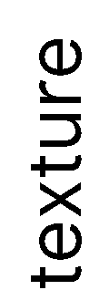
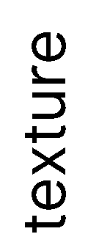

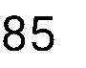

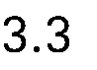

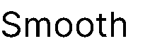
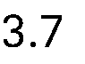
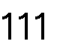

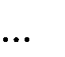
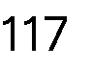
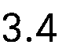
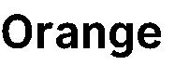
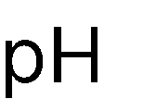
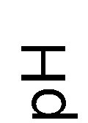

Random Subspace Method at training time
Training data

Slide 21

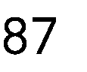


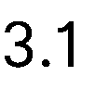

Random Subspace Method at inference time
A test sample
66% confidence

Slide 22
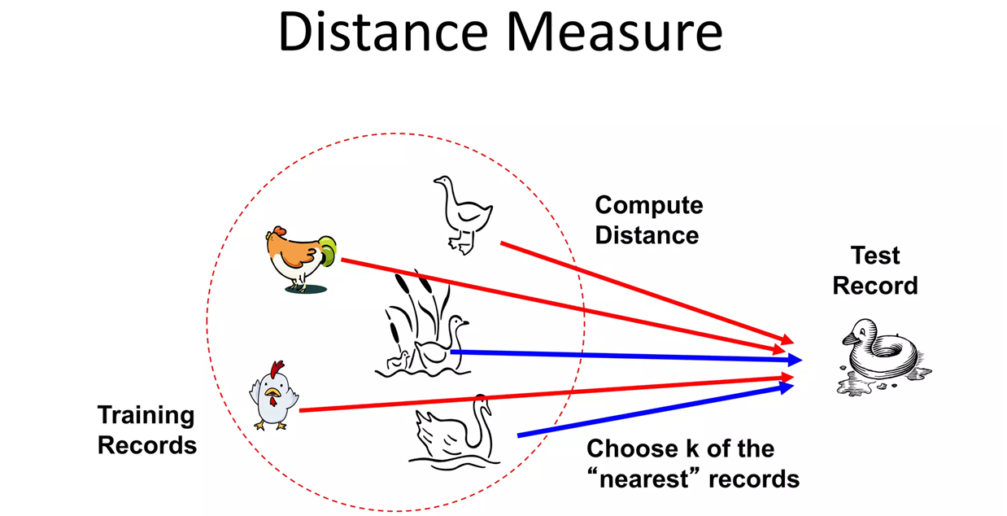
K-Nearest Neighbors
KNN is a type of supervised ML algorithm which can be used for both classification as well as regression predictive problems. However, it is mainly used for classification predictive problems in industry.
It is a Lazy Learning Algorithm because it does not learn from the training set immediately instead it stores the dataset and at the time of classification, it performs an action on the dataset.
This technique implements classification by considering majority of vote among the "k" closest points to the unlabeled data point.
Euclidean Distance or Manhattan Distance are used as metric for calculating the distance between points.

Slide 23
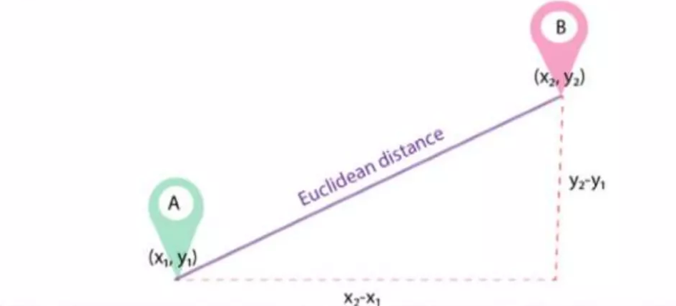
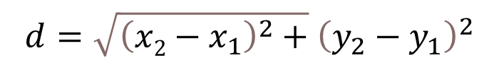
Euclidean Distance
The Euclidean distance between two points in the plane with coordinates ( x 1,y1) and ( x 2,y2) is given by-
$$d=\sqrt{{\left(x2−x_{1}\right)}^{2}+}{\left(y_{2}−y_{1}\right)}^{2}$$

Slide 24

K-Nearest Neighbors
Green circle is the unlabeled data point.
K=3 in this problem
Closest 3 points taken
2 are Red
1 is Blue
Votes: 2 Red > 1 Blue
So, Here the Green circle will be Red triangle.

Slide 25

K-Nearest Neighbors
Green circle is the unlabeled data point.
K=5 in this problem
Closest 3 points taken
2 are Red
3 is Blue
Votes: 2 Red < 3 Blue
So, Here the Green circle will be Blue rectangle.

Slide 26
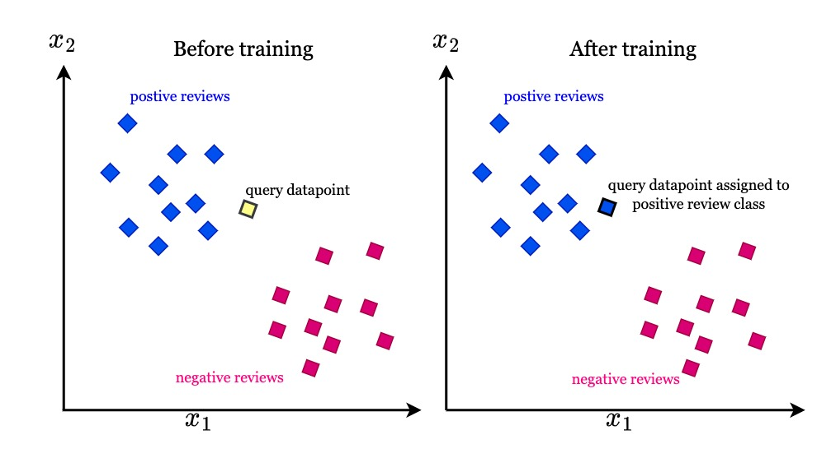

Slide 27
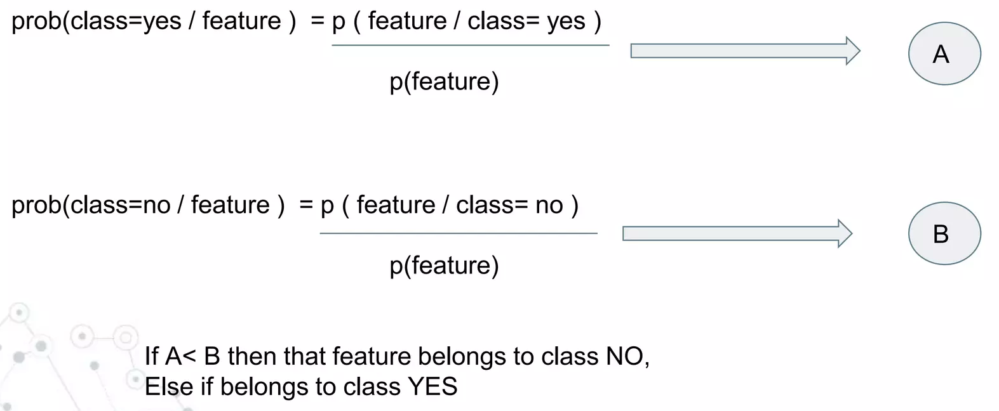
NAÏVE BAYES
Naive Bayes is a probabilistic classifier based on Bayes' theorem with an assumption of independence between features. Despite its "naive" assumption, it often performs well in practice .
Naive Bayes is commonly used for text classification, spam filtering, and other tasks involving probability estimation. It's computationally efficient and works well with high-dimensional data.

Slide 28
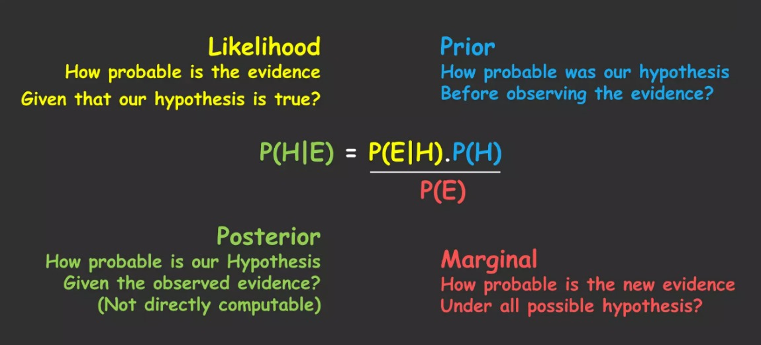

Slide 29
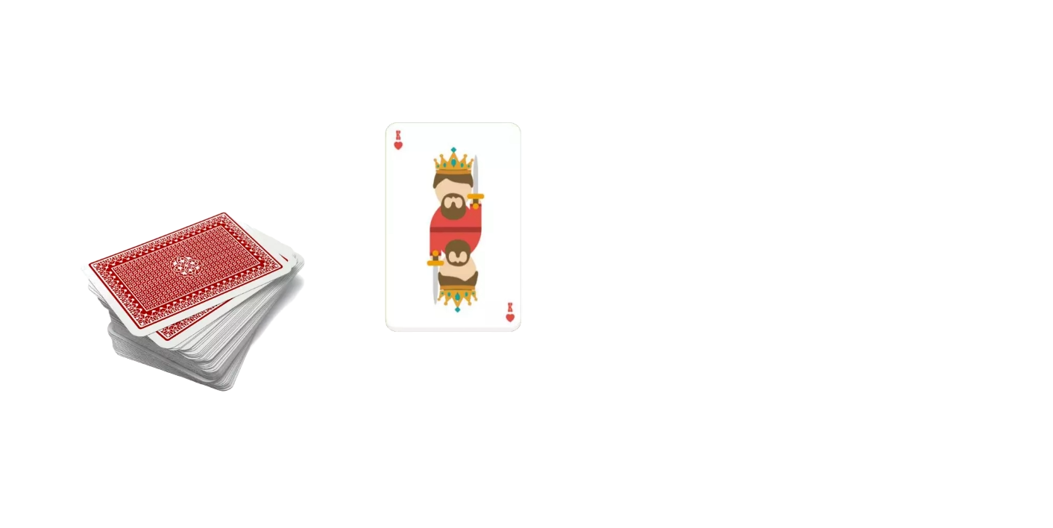
Baye’s Theorem Example
Given we have a complete deck of 52 cards and we have to draw a single one out. Find the probability that the card is a king, given that the chosen card is face card.

Slide 30
Baye’s Theorem Example
P(KING)=4/52=1/13

Slide 31
Baye’s Theorem Example
P(KING)=4/52=1/13
P(KING|FACE)=P(FACE|KING).P(KING)
-------------------------------
P(FACE)

Slide 32
Baye’s Theorem Example
P(KING)=4/52=1/13
P(KING|FACE)=P(FACE|KING).P(KING)
-------------------------------
P(FACE)

Slide 33
Baye’s Theorem Example
P(KING)=4/52=1/13
P(KING|FACE)=P(FACE|KING).P(KING)
-------------------------------
P(FACE)
= 1.(1/13)
---------- =1/3
(3/13)

Slide 34
FLOWCHART

Slide 35
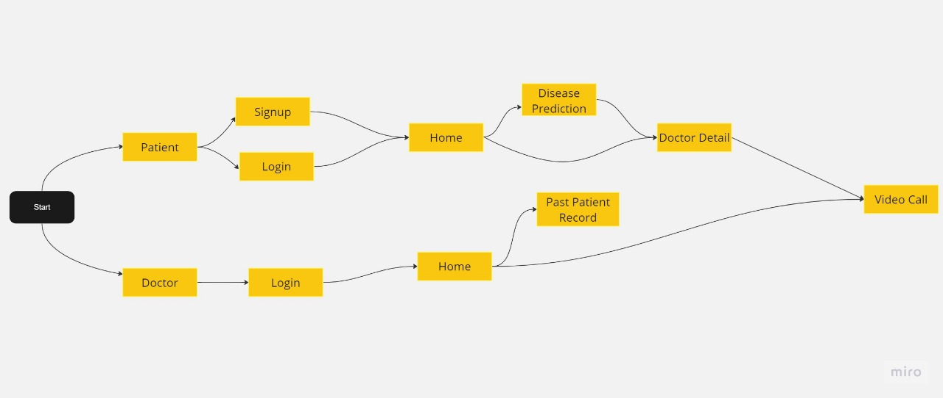

Slide 36
USER INTERFACE

Slide 37
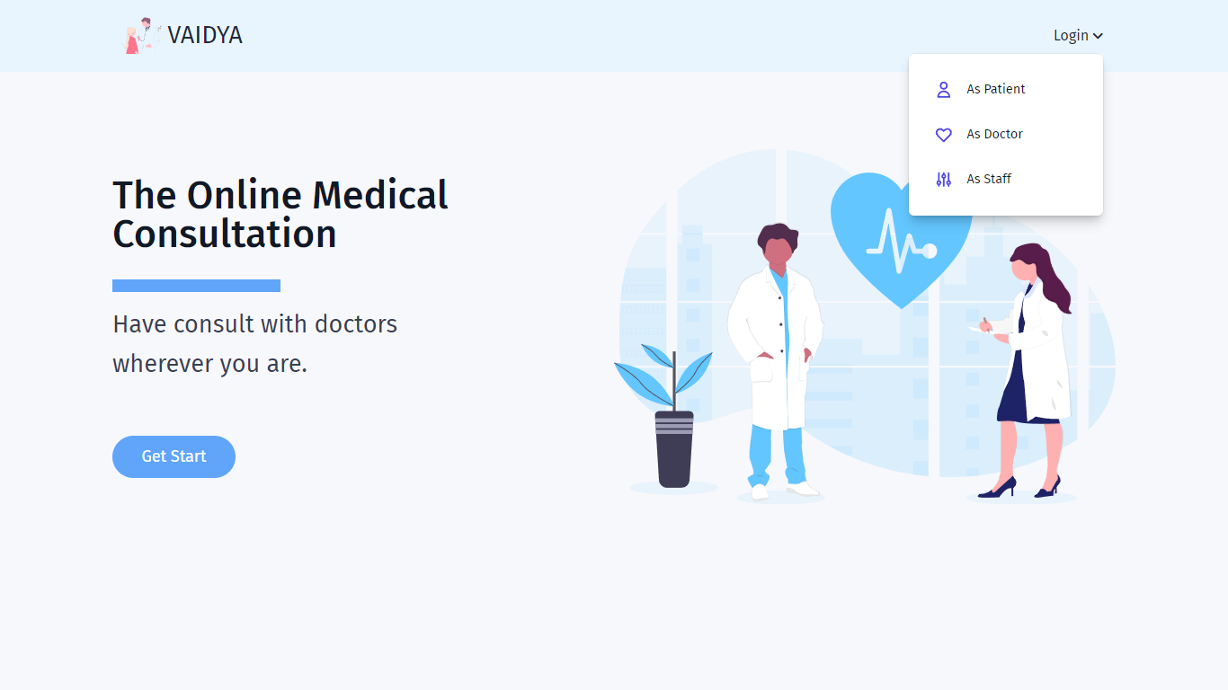

Slide 38
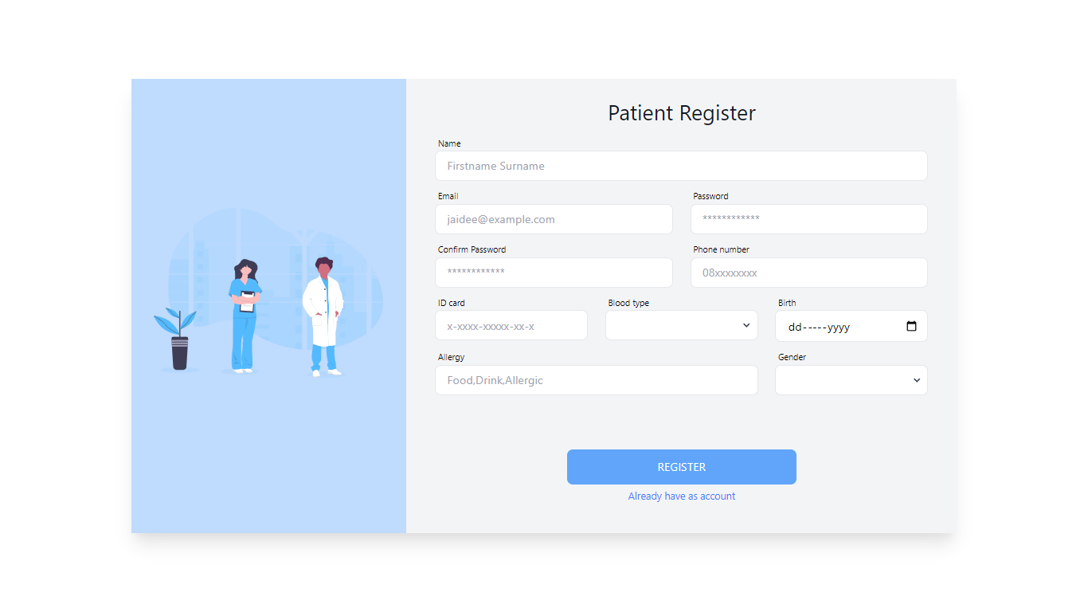

Slide 39
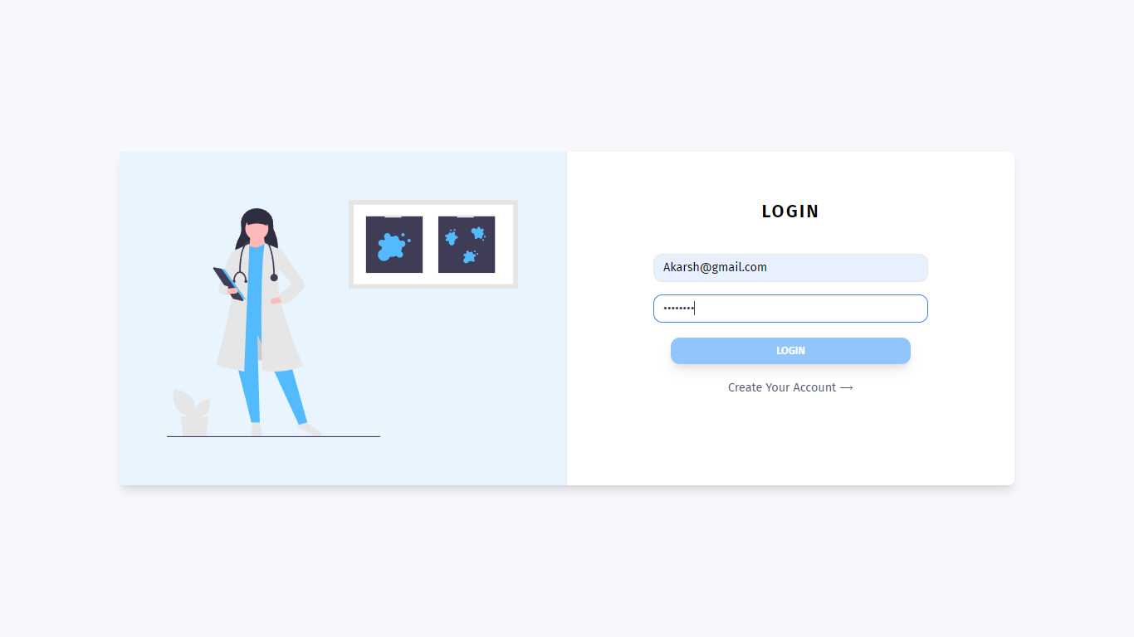

Slide 40
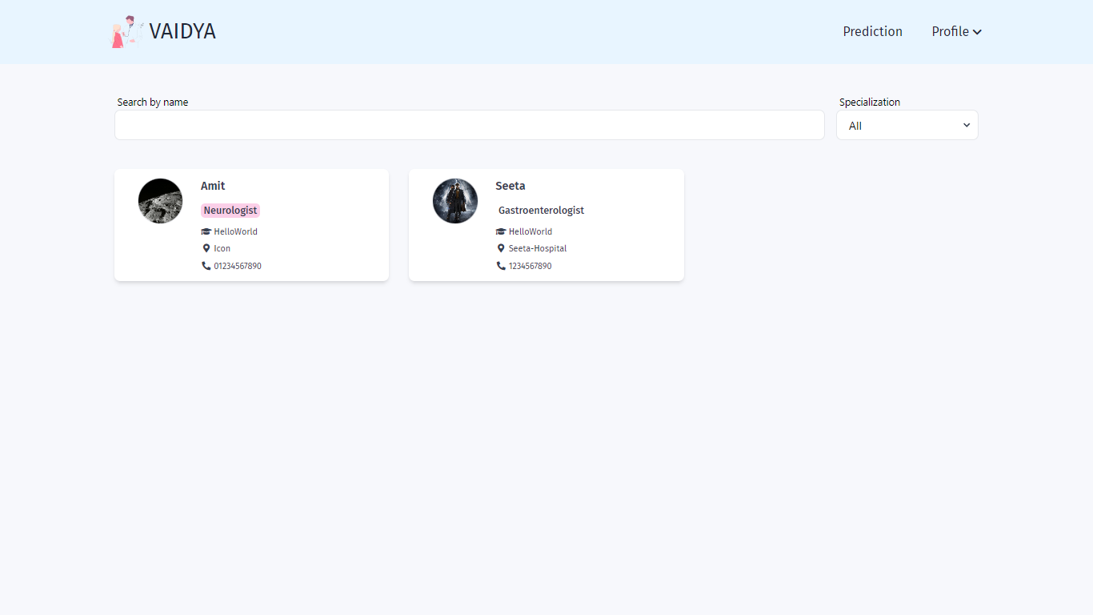

Slide 41
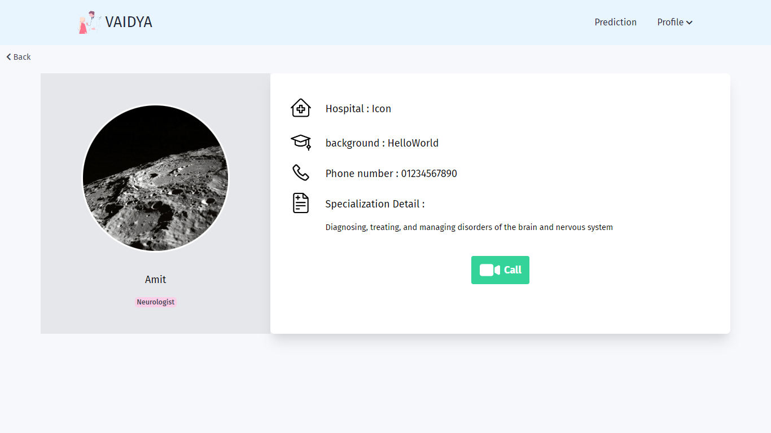

Slide 42
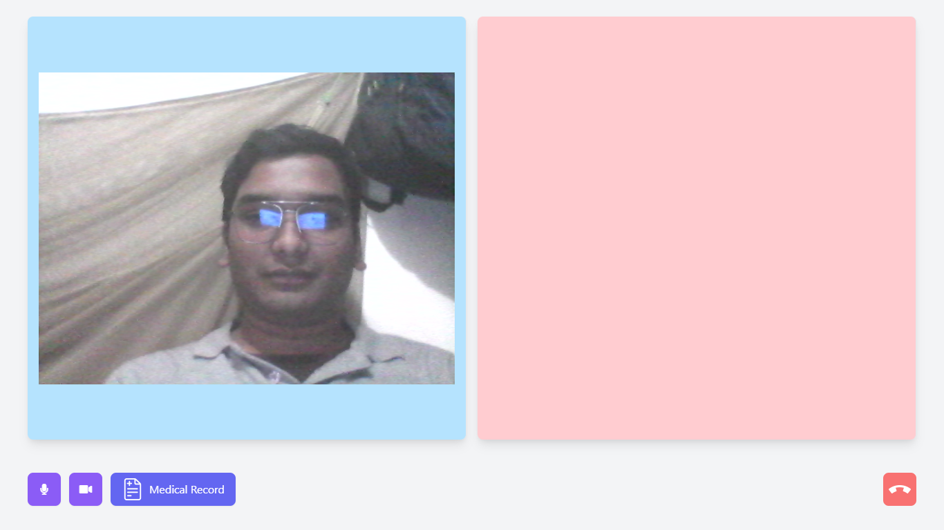
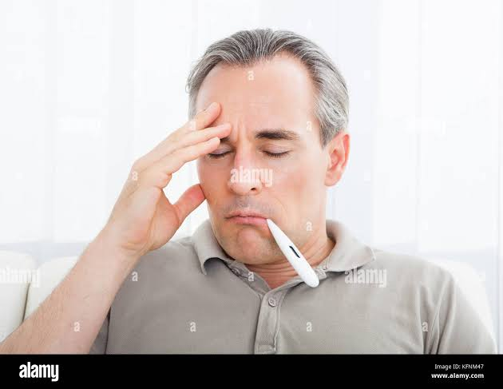


Slide 43
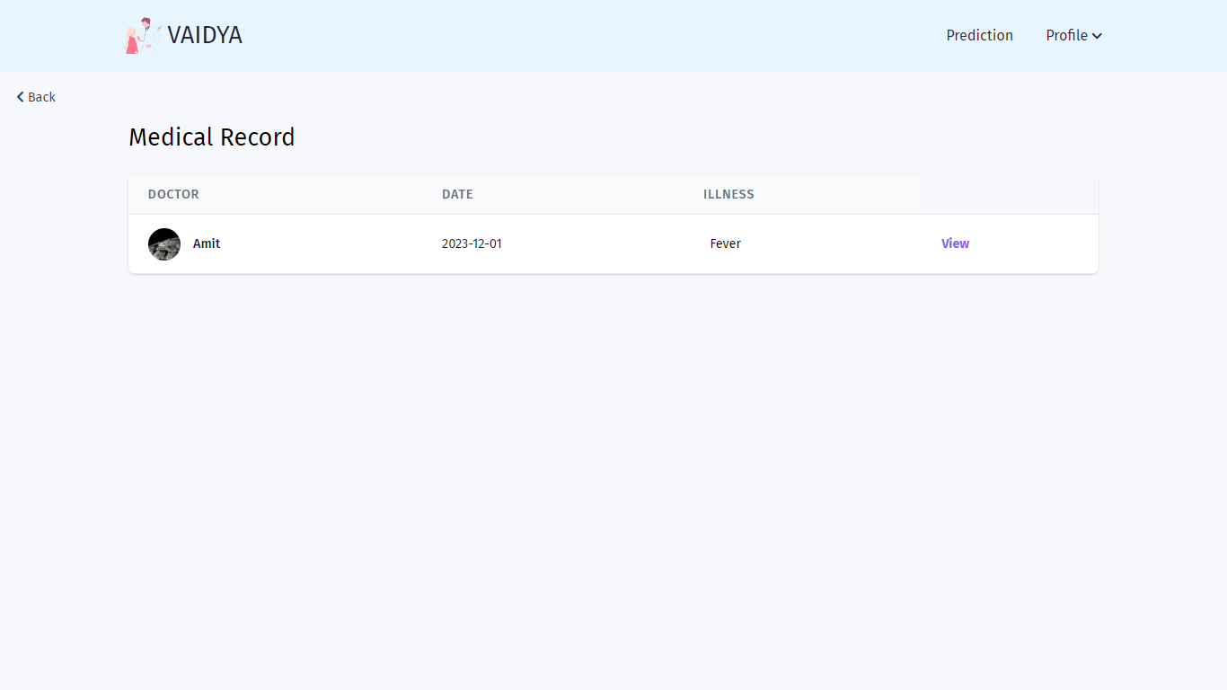

Slide 44
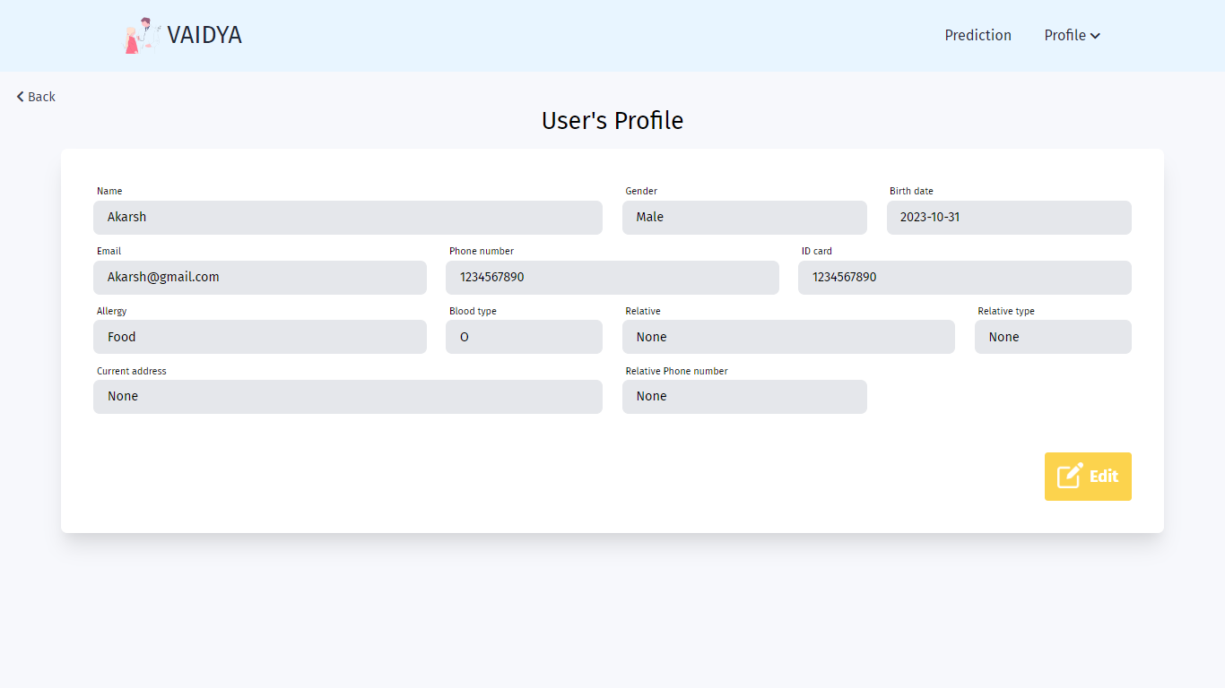

Slide 45
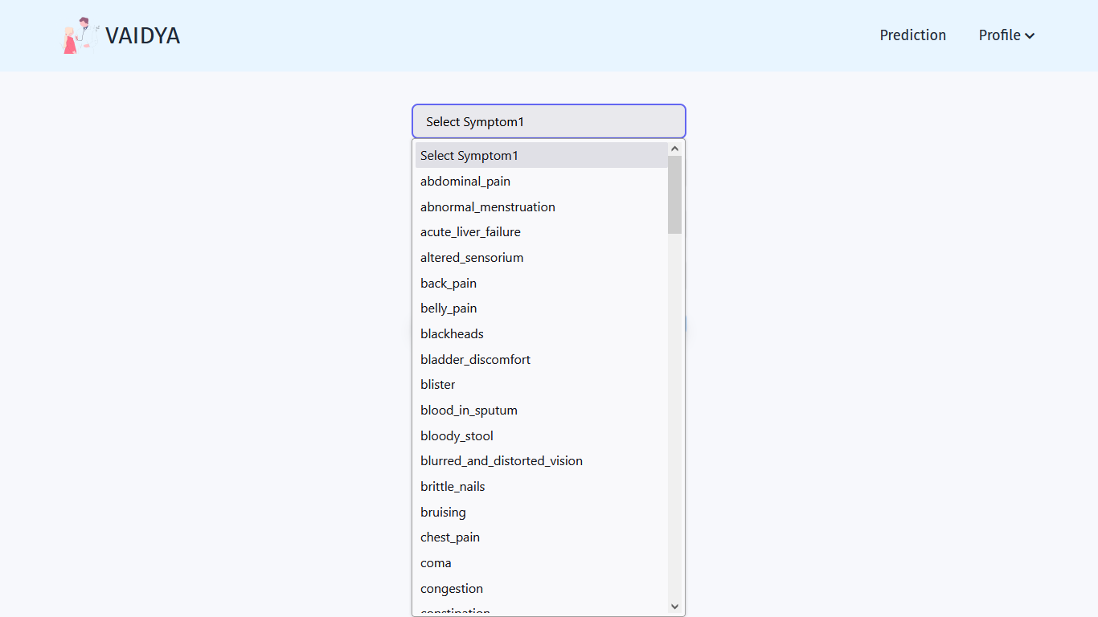

Slide 46
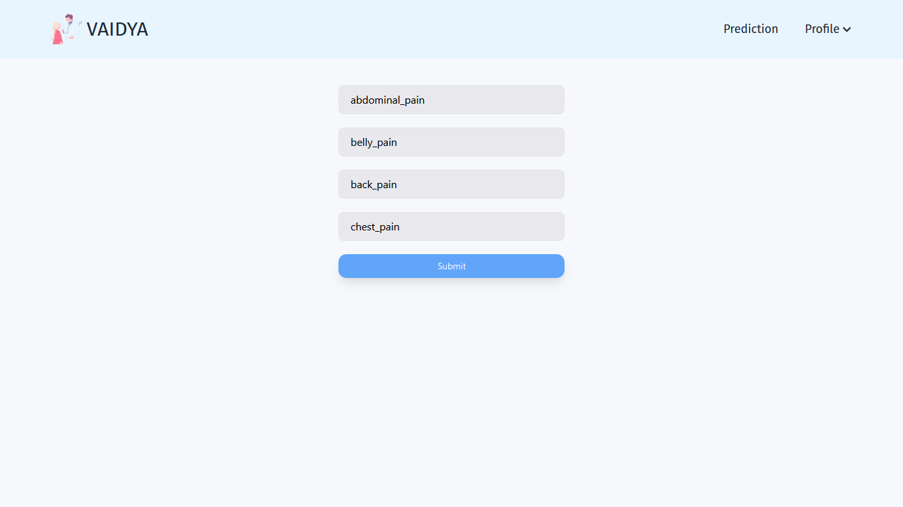

Slide 47
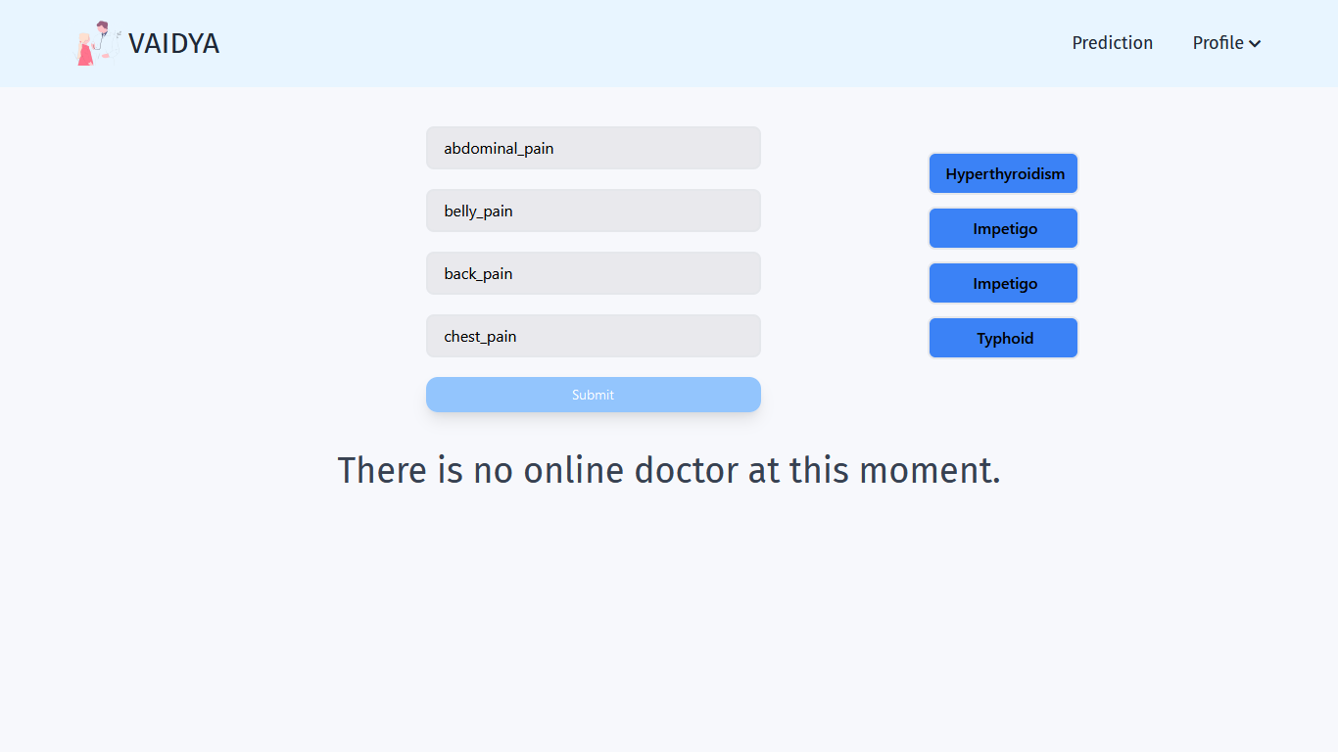

Slide 48
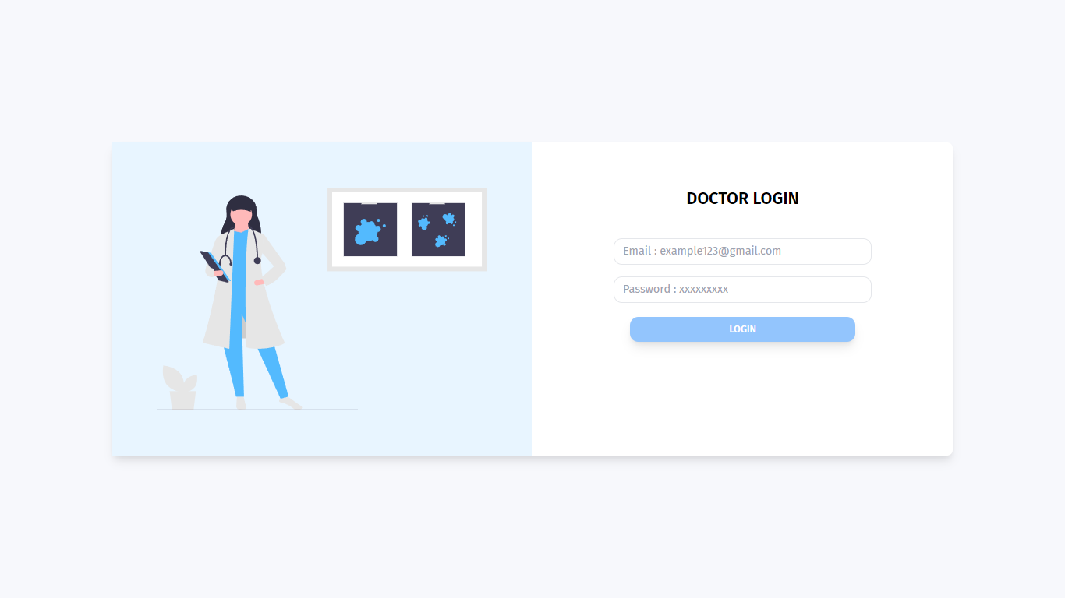

Slide 49


Slide 50


Slide 51


Slide 53


Slide 54


Slide 55


Slide 56


Slide 57


Slide 58


Slide 59


Slide 60
CODE
AND STRUCTURE

Slide 61


Slide 62


Slide 63


Slide 64


Slide 65


Slide 66


Slide 67


Slide 68


Slide 69


Slide 70


Slide 71


Slide 72


Slide 73


Slide 74


Slide 75


Slide 76
References [IEEE format]
Here specify the description of the study material referred for the development of project
Pranay Patil. “Disease Symptom Prediction helps to create a disease prediction or healthcare system” Kaggle.com. https://www.kaggle.com/datasets/itachi9604/disease-symptom-description-dataset (accessed Aug. 21,2022).

Slide 77
THANK YOU

